Slide 1
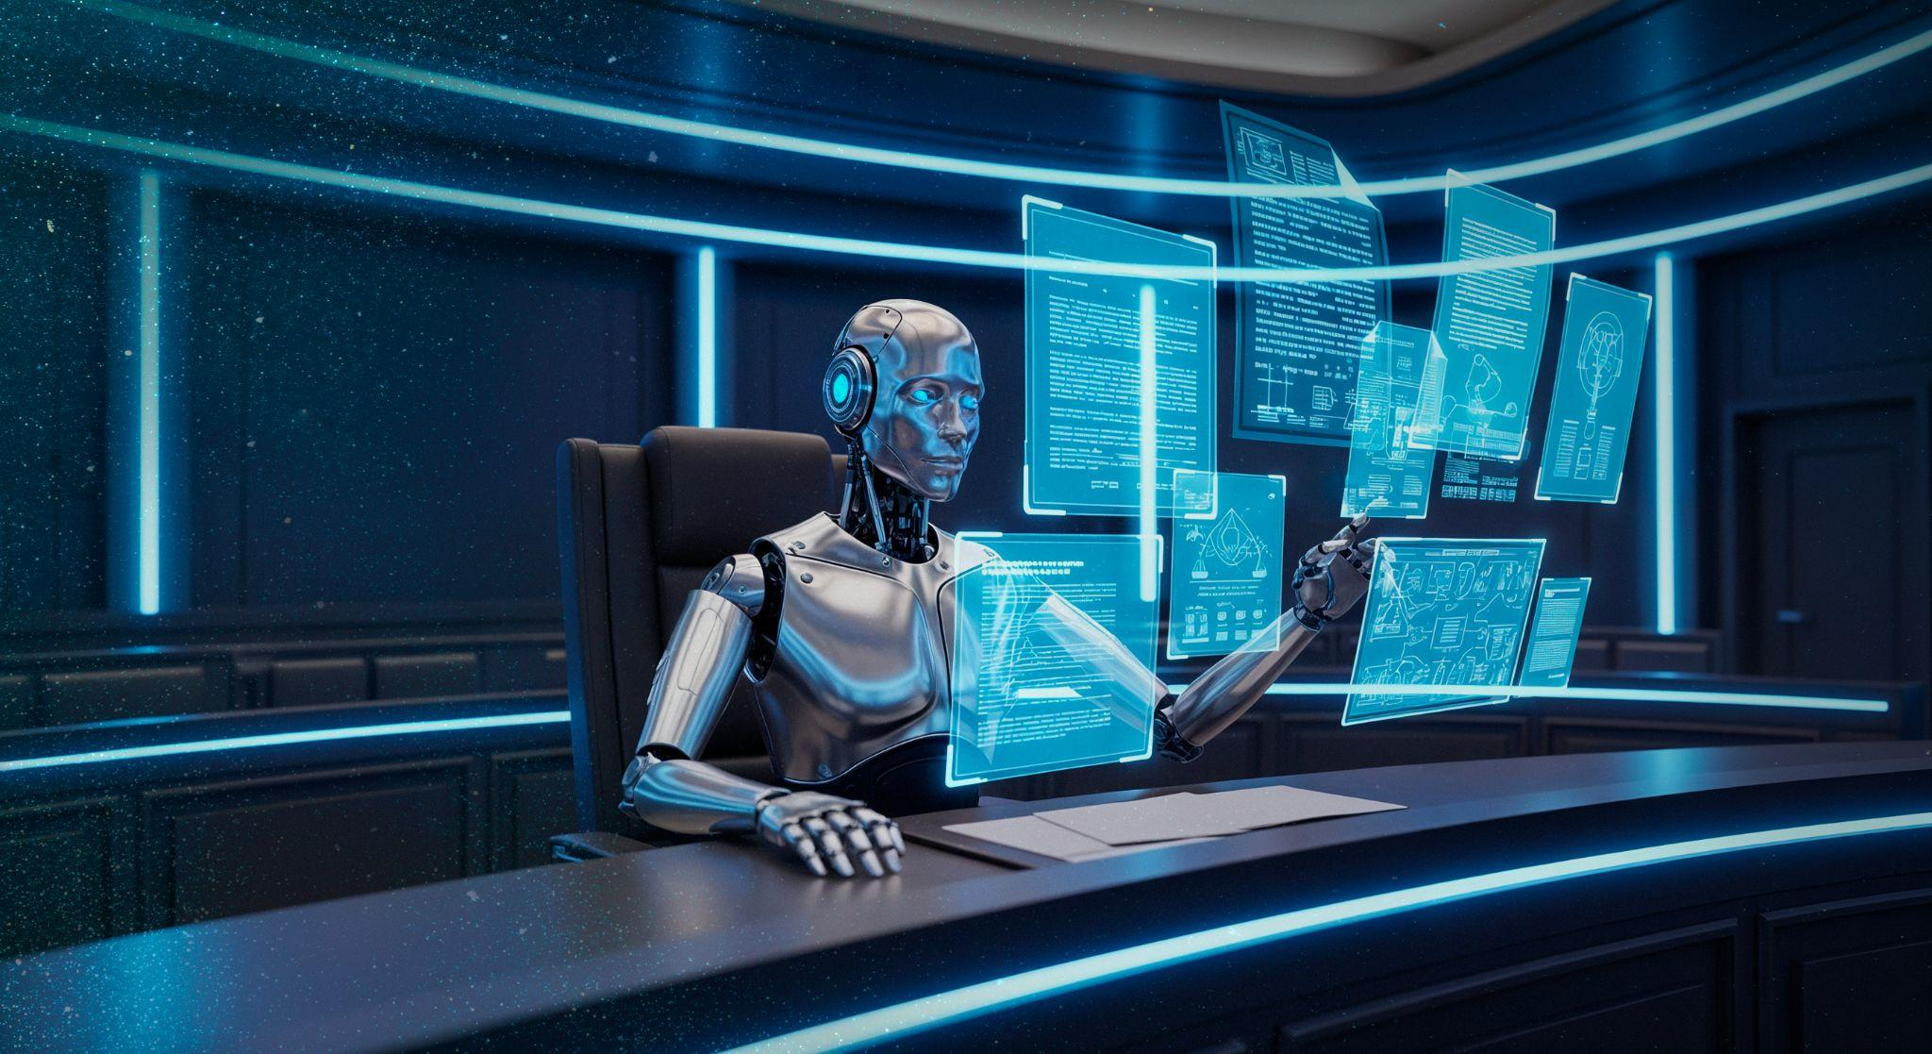
AI
AN INTRODUCTION
FutureQuest Year 10 Lesson
University of Bristol
Notes:
Use a menti or board to evaluate:
- What do you currently know about AI?
- What examples of AI are you aware of?
- Are there any ethical issues regarding AI?

Slide 2

Notes:
If there are tech issues, you need to set up etc, this 5 min video will buy some time ☺

Slide 3
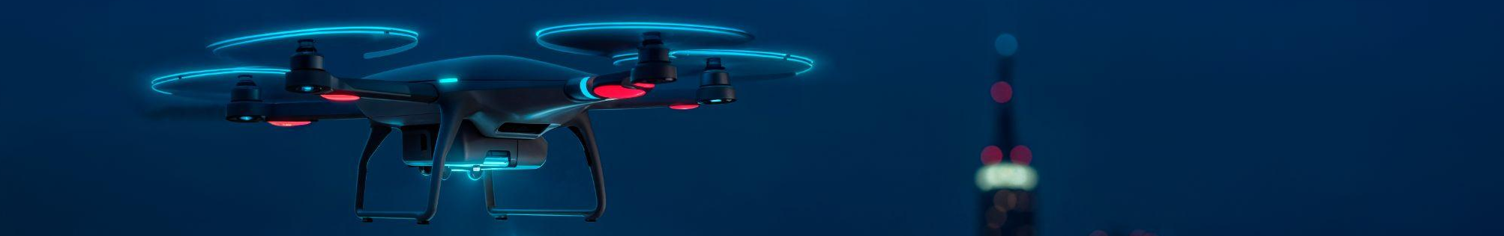
TABLE OF CONTENTS
01
05
02
06
03
07
04
08
What is Data
Applications of AI
What is AI
Benefits of AI
How Machines Learn
Issues with AI
Acting Like AI
Responsible AI

Slide 4
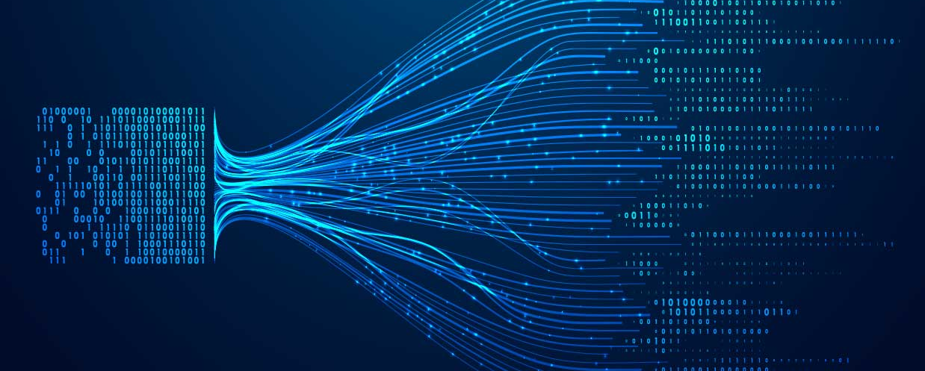
01
WHAT IS DATA
Notes:
Image from: https://www.highdigital.co.uk/blog/preparing-your-companys-data-for-ai/

Slide 5
DATA DEFINITIONS
‘facts and statistics collected together for reference or analysis.’
– Oxford Languages
‘Data is information in raw form, collected from observations, measurements, or digital sources, and used for analysis or decision-making.’
– ChatGPT
Data can be:
structured, allowing it to be organised easily (e.g., people’s names)
unstructured, requiring sophisticated analysis (e.g., a picture)
semi-structured, containing some organisation (e.g, an email)
We can collect data from anything.

Slide 6
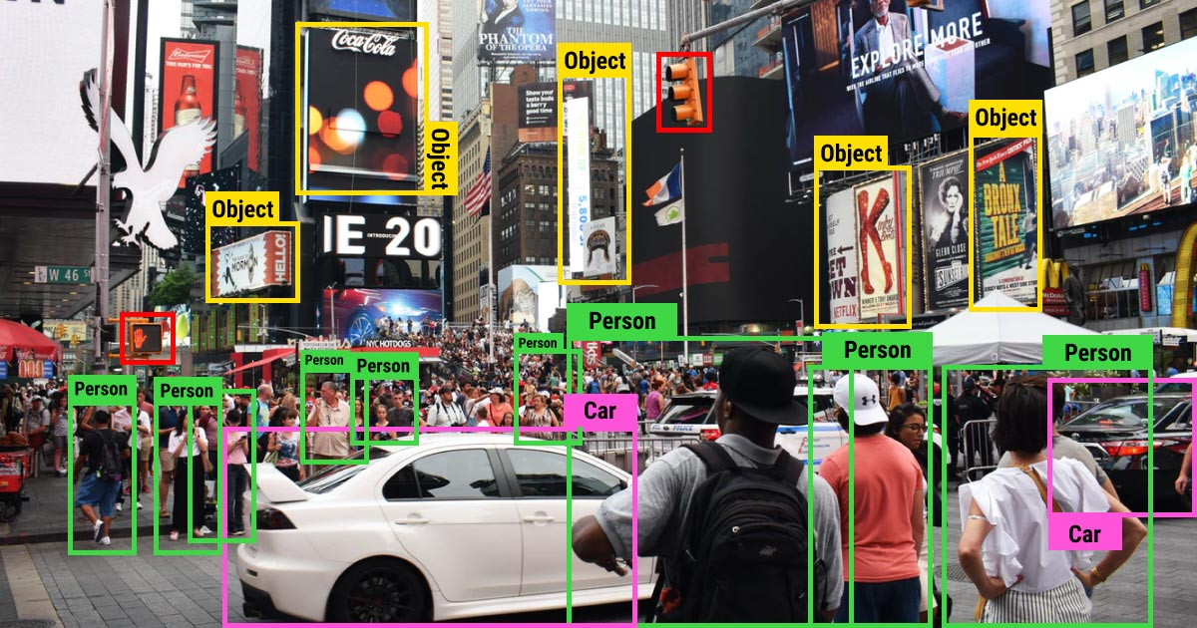
Data is Everywhere
Notes:
Image from: https://www.augmentedstartups.com/blog/a-comprehensive-guide-to-image-classification-in-2023?srsltid=AfmBOoq0lcpbW3tLvNV1YESHOogioZ-_i2xY0kVHe63dU8v96jIq4l8t

Slide 7
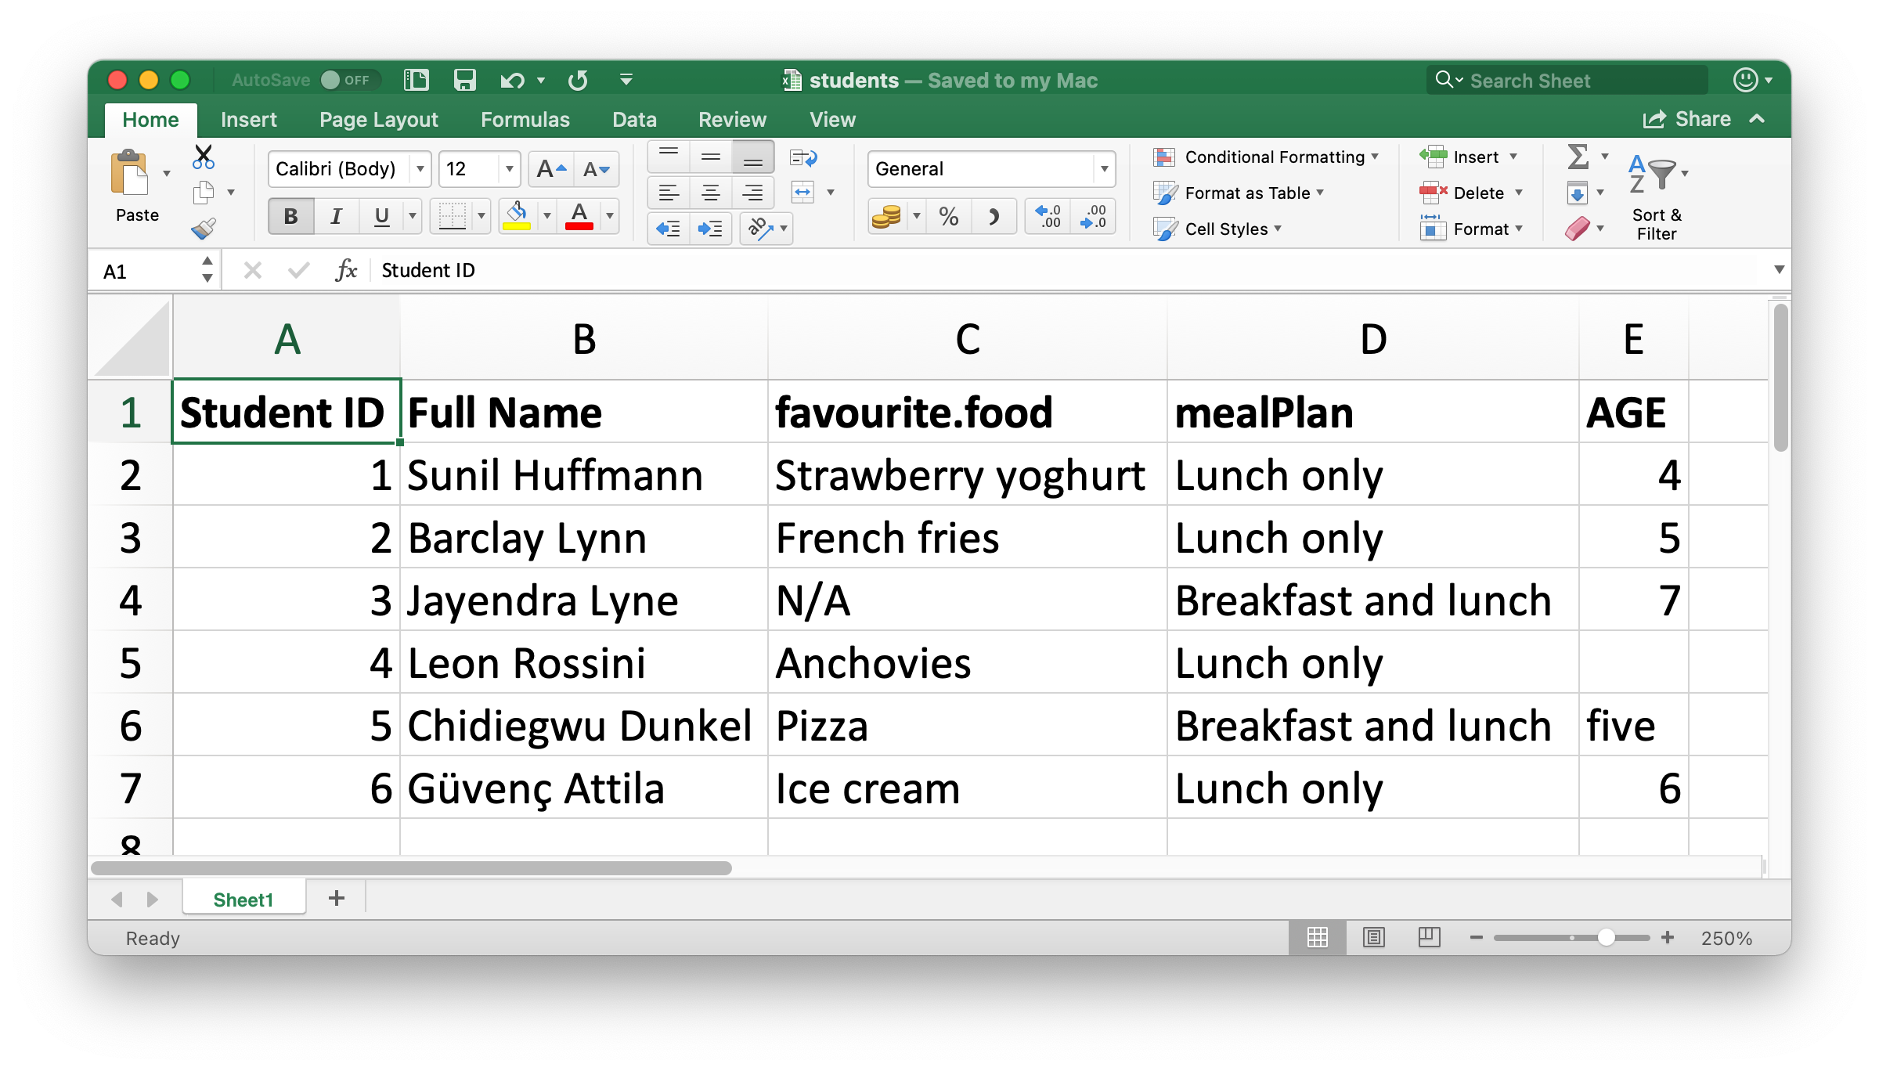
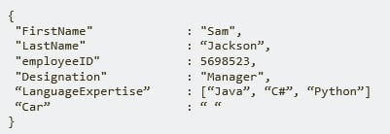
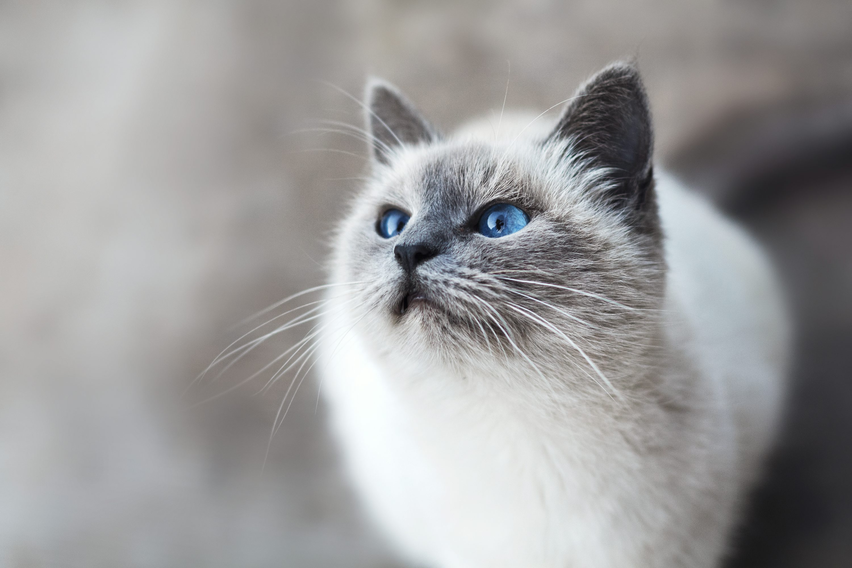
WE RECORD DATA IN MANY WAYS
THESE IMAGES ARE EXAMPLES OF THE TYPES OF DATA
Which of the images are structured, unstructured, and semi-structured

Slide 8
DATA CHALLENGES
While data is useful, it suffers from:
Availability & Representativeness
  Does relevant data exist, and does it accurately reflect the problem domain?
Data Imbalance
  Is there an equal distribution of classes or categories?
Privacy & Compliance
  Does the storage or use of data adhere to legal and ethical standards?
Missing or Incorrect Data
  Are there gaps or errors caused by the data collection?
Anomalies
  Are there outliers or unexpected values?
Bias
  Are there systematic errors in the data that lead to unfair/inaccurate analysis?

Slide 9
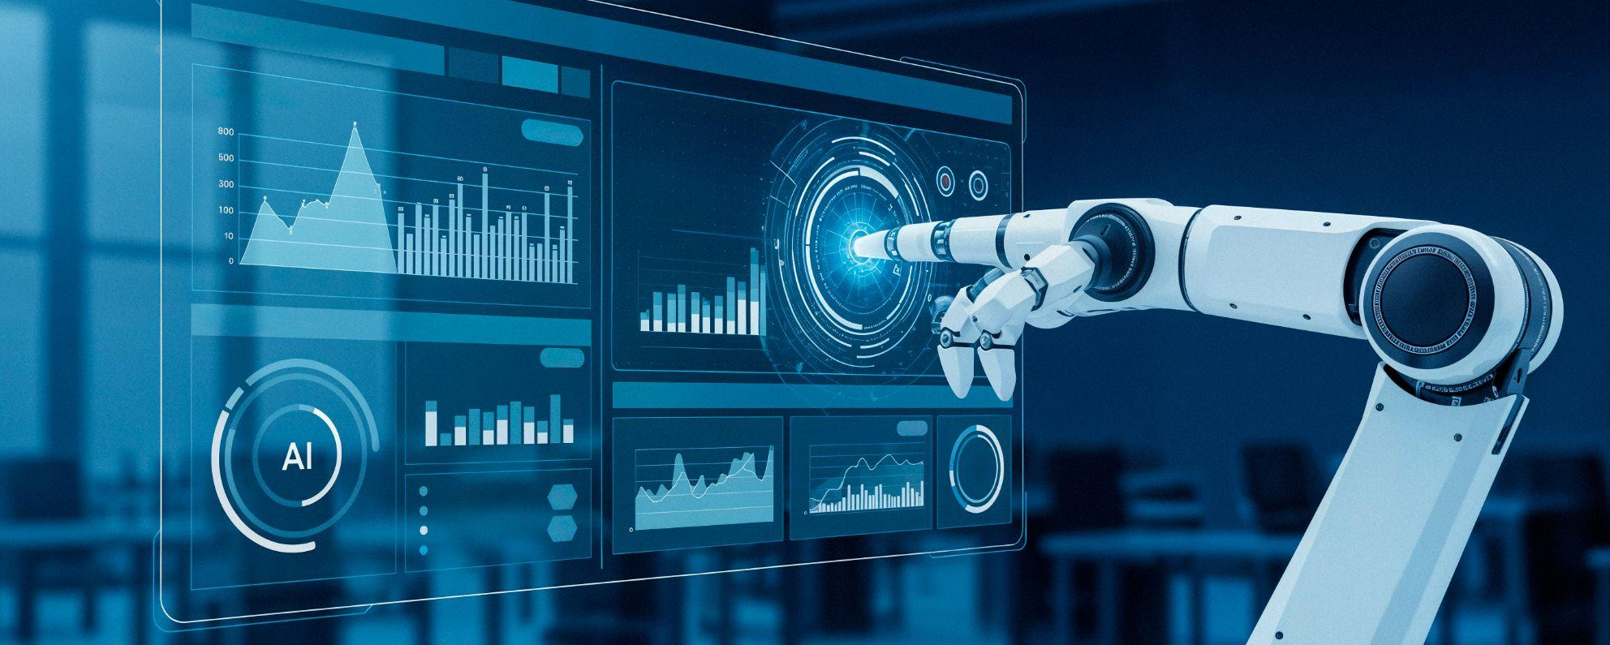
02
WHAT IS AI

Slide 10
AI DEFINITION
Technology that enables computers and machines to simulate human learning, comprehension, problem solving, decision making, creativity and autonomy
The term Artificial Intelligence first appeared in 1956 at a workshop
However, people had been asking if machines could think much earlier than this
The three key areas of modern AI are Data, Algorithms, and Computational Power
We’ve already covered Data
Algorithms are sets of rules that AI follows to learn from data
Computational Power is a system's capacity to process data and execute instructions

Slide 11
HOW AI DIFFERS FROM TRADITIONAL PROGRAMMING
Traditional Programming
Explicit Rules
Rules coded by humans
Inputs and Outputs defined by code
Works well for rule-based tasks
Works well in predictable tasks
Example: In spam detections, traditional programming uses set rules (e.g., “if subject contains ‘win,’ mark as spam”)
Artificial Intelligence
Rules based on patterns
Rules interpreted by an algorithm
Inputs and outputs defined by data
Works well for pattern tasks
Works well in unseen tasks
Example: In spam detection, AI learns from email patterns and user feedback

Slide 12
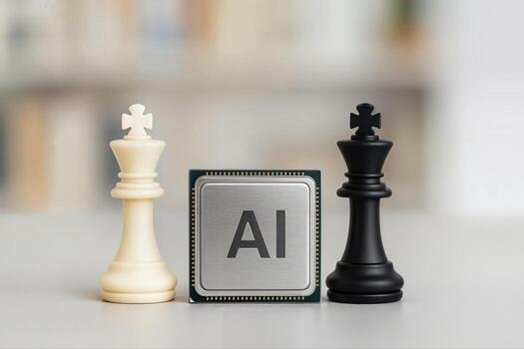
TYPES OF AI
Data-Driven
AI
Knowledge-Driven AI
learns patterns from vast amounts of data
Examples include:
Supervised Learning
Unsupervised Learning
Reinforcement Learning
We will cover this today
focuses on explicit, rule-based, human-readable logic (e.g., a traditional chess AI)
Examples include:
Symbolic AI
Logic-Based AI
Notes:
Image from: https://www.vecteezy.com/free-photos/ai-chess

Slide 13
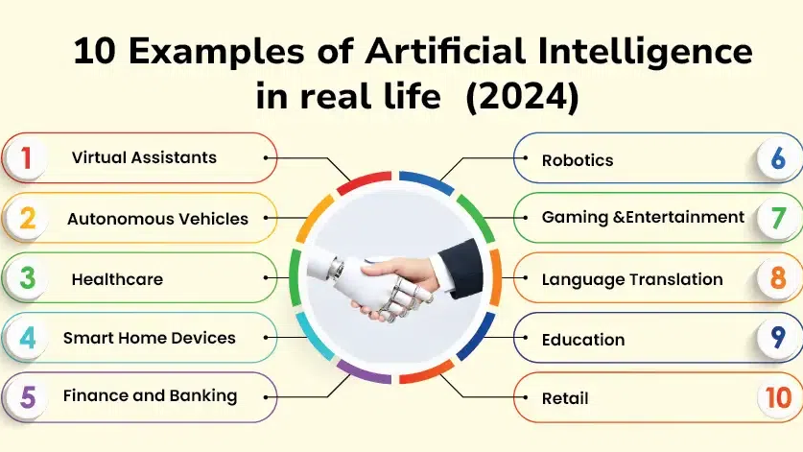
Notes:
What examples of AI can you think of?
Image from: https://www.geeksforgeeks.org/artificial-intelligence/10-examples-of-artificial-intelligence-in-real-life-2024/

Slide 14
WHY DO WE USE AI?
Discover complex patterns in data
  These are usually patterns that are difficult (or impossible) for humans to detect manually
Predict outcomes
  To allow for informed decisions using data, which can be new or unseen
Automate repetitive and time-consuming tasks
  Enhancing the efficiency of processes and humans
Minimise human error
  Through improving the accuracy and consistency of processes

Slide 15
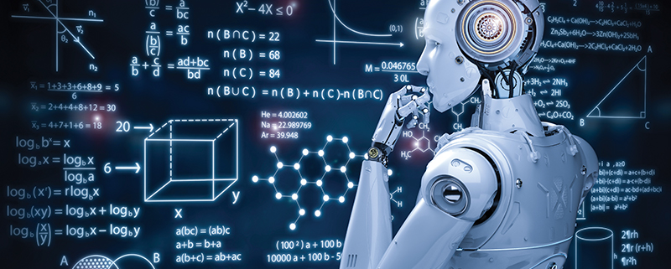
03
HOW MACHINES LEARN
Notes:
Image from: https://broadbandlibrary.com/ever-wonder-how-machines-learn/

Slide 16
SUPERVISED LEARNING
Uses labelled data
Each data point has a known output (known as a label)
Types of data include:
Numeric (Regression): Continuous values (e.g., house prices, temperatures)
Categorical (Classification): Discrete classes (e.g., spam vs. non-spam)
Ordinal (both): Categories with a natural order (e.g., ratings like poor, fair, good)
Common Supervised Models:
Regression: Predicts continuous values (e.g., Linear Regression [next slide])
Classification: Predicts categories and classes (e.g., Decision Trees [slide after next])

Slide 17
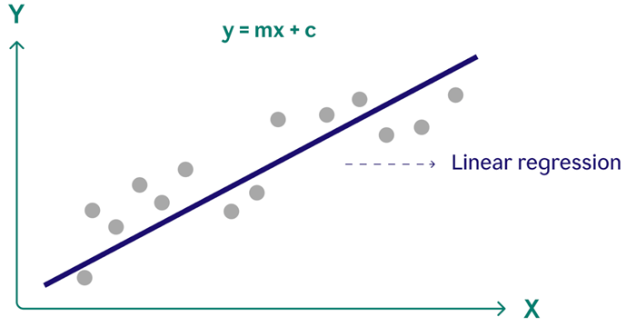
LINEAR REGRESSION
Purpose:
Predict a continuous numeric value
How it works:
It learns the relationship between input features and outputs by adjusting parameters to fit a decision boundary (often a line or curve)
How it works mathematically:
The model fits a straight line to the data using the equation: y^​ = wx+b
Applications:
Predict house prices
Estimate salaries
Forecasting stock prices

Slide 18
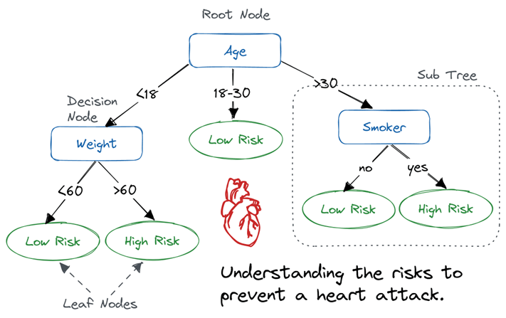
DECISION
TREES
Purpose:
Used for both classification and regression tasks.
How it works:
The model makes decisions by splitting data into branches based on feature values. At each node, it asks a yes/no question and continues down the tree until it reaches a leaf node with a prediction.
How it works mathematically:
The algorithm selects the best feature
and split point at each node using an algorithm such as Information Gain.
Applications:
Spam detection
Loan approval
Diagnosing medical conditions

Slide 19
UNSUPERVISED LEARNING
Uses unlabelled data
The data does not have known outputs
No predefined labels
Model looks for patterns, groupings, and relationships
Model must find the structure itself
Common Supervised Models:
Clustering: Groups similar data points together (e.g., K-Means Clustering [next slide])
Association Rule Learning: Finds relationships between variables (e.g., Market Basket Analysis [not covered today])

Slide 20
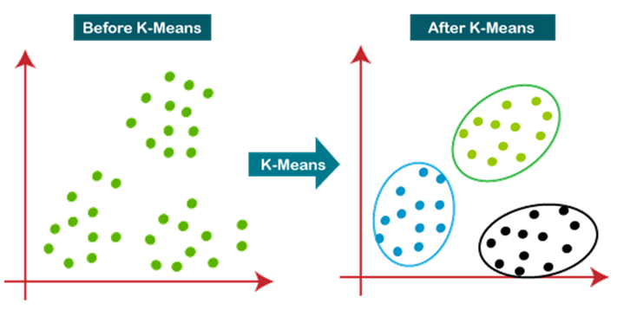

K-MEANS CLUSTERING
Purpose:
A clustering algorithm that groups data points into K distinct clusters based on similarity.
How it works:
Choose a number of clusters (K), Randomly initialize K centroids, Assign each point to the nearest centroid, Recalculate centroids as the mean of assigned points, Repeat until clusters no longer change (convergence)
How it works mathematically:
The algorithm aims to minimize the
intra-cluster variance
Applications:
Customer segmentation
Image compression
Document or topic grouping

Slide 21
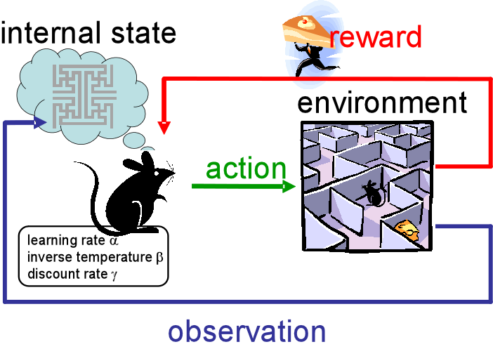
REINFORCEMENT LEARNING
Learns through interactions
The model learns by interacting with an environment, and receiving feedback in the
form of rewards or penalties:
No explicit labels
Model learns a policy (strategy)
Involves states, actions, and rewards
Applications:
Autonomous vehicles
Robotics and Automation
Playing games

Slide 22
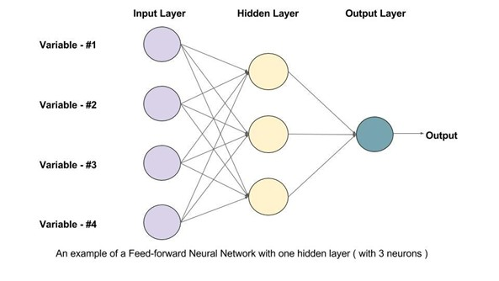
DEEP LEARNING
Learning with Neural Networks:
A type of machine learning that uses artificial neural networks with many layers to learn complex patterns from large datasets
Inspired by the human brain
Excels at learning from unstructured data
Requires large amounts of data and power
Applications:
Image recognition (e.g., face detection)
Natural language processing (e.g., ChatGPT)
Speech recognition

Slide 23
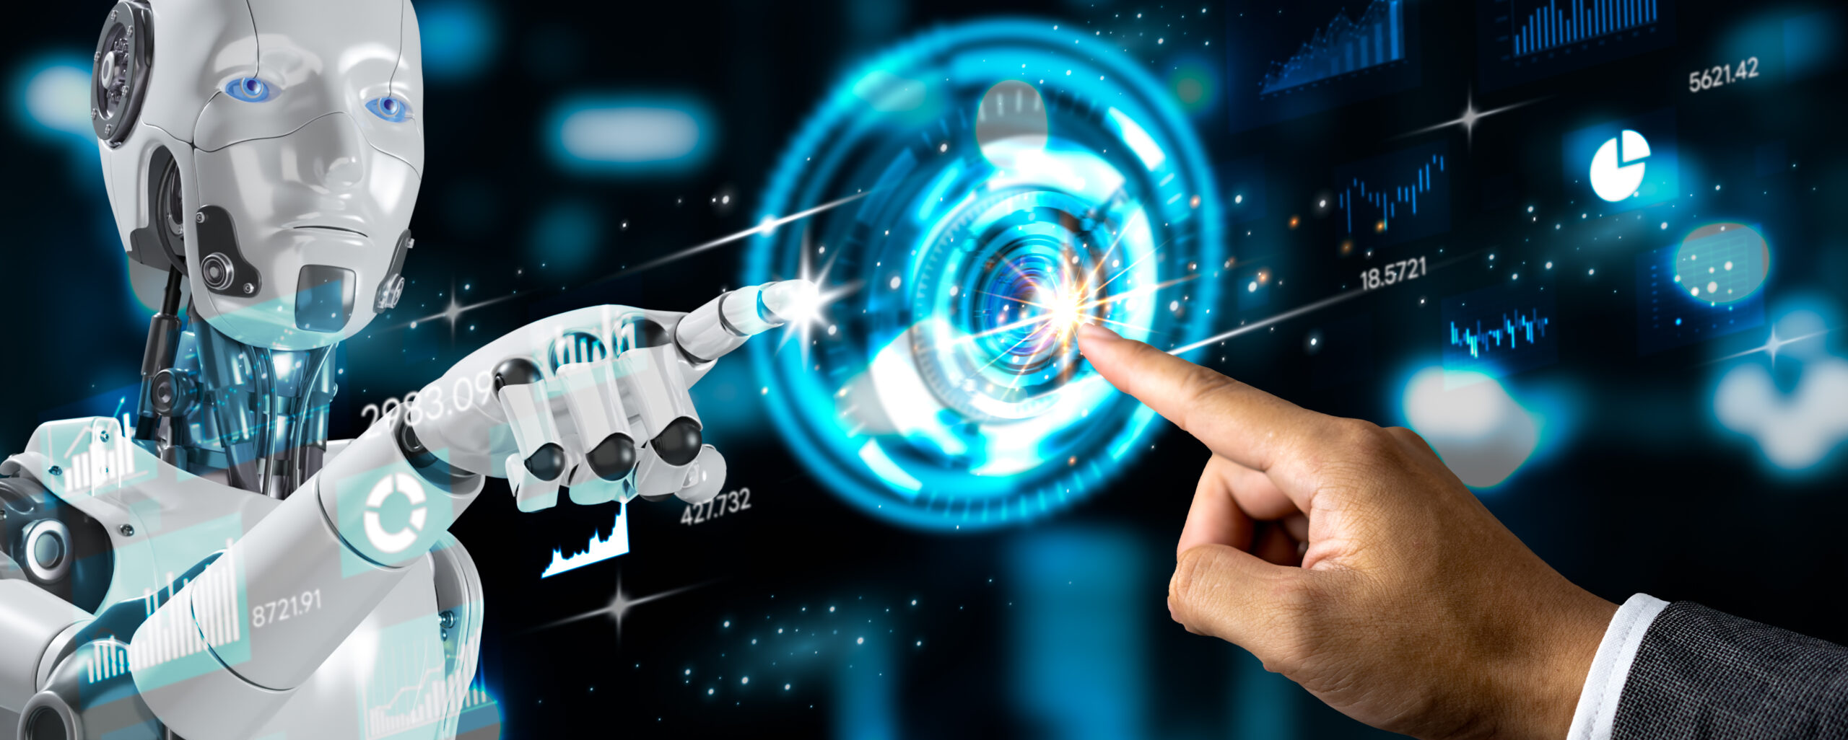
04
ACTING LIKE AI
Notes:
Image from: https://essentialengine.com/you-need-to-stop-acting-like-a-robot/

Slide 24
Part 1: Clustering (7 Minutes)
You have been provided with 10 user profiles
You must group the users into 3 groups
Explain your reasoning behind the groupings
Notes:
Students receive the 10 user profiles and cluster them into 3 groups based on what they think makes sense for ad targeting.
They must write down the reasoning behind their groupings.

Slide 25
Part 2: AI Clustering (5 Mins)
Get a Generative AI (ChatGPT, Bard, Gemini, etc.) to cluster the users
What patterns do you see in the AI’s groups?
How do they compare to yours?
Does it cluster by age?
Does it cluster by income?
Does it cluster by interests?

Slide 26
Cluster 1: Young Urban, Low Income, Smoker, Digital/ Social Lifestyle
Users: 1, 4, 6, 9
Profile:
Ages: 19–28
Income: Low ($15k–$40k)
Location: Urban
Health: Mostly smokers
Interests: Gaming, social media, tech, music
Occupations: Students, retail, freelance
Summary: lower income, more likely to smoke
Cluster 2: Mid-Age Professionals, Health-Conscious, Active Lifestyle
Users: 2, 3, 8, 10
Profile:
Ages: 34–45
Income: High ($45k–$90k)
Health: Non-smokers
Interests: Running, cooking, yoga, travel, outdoor activities
Occupations: Skilled professionals (manager, nurse, lawyer, chef)
Summary: Stable careers, health-conscious, active
Cluster 3: Older, Rural/Suburban, Non-Smoker, Nature-Oriented
Users: 5, 7
Profile:
Ages: 52–60
Income: Mid ($30k–$85k)
Location: Rural
Health: Non-smokers
Interests: Gardening, reading, hiking
Occupations: Engineer, retired teacher
Summary: Older individuals with quieter, nature-focused lifestyles
Notes:
Slide for offline lessons

Slide 27
Part 3: Ad Assignment (8 mins)
You must now assign ads to either the AI’s or your own clusters.
Compare how ad targeting differs when based on AI clusters vs human intuition.
For each assignment, you should ask:
Is this ethical?
Could this harm or mislead this group?

Slide 28
Part 4: Discussion & Reflection (10 mins)
What did the AI miss that you considered?
Did it group people in a way that felt unfair or biased?
Could AI reinforce ageism, classism, or health discrimination?
Who should be responsible for checking these AI decisions?

Slide 29
The Users
User ID | Age | Occupation | Interests | Income | Health Status | Ethnicity | Location
1 | 22 | Student | Gaming, Music | $15k | Smoker | Hispanic | Urban
2 | 45 | Office Manager | Running, Cooking | $60k | Non-smoker | White | Suburban
3 | 34 | Nurse | Yoga, Gardening | $50k | Non-smoker | Black | Urban
4 | 19 | Retail Worker | Fast Food, Social Media | $18k | Smoker | Asian | Urban
5 | 52 | Engineer | Hiking, Reading | $85k | Non-smoker | White | Rural
6 | 28 | Freelancer | Tech, Video Games | $40k | Smoker | Black | Urban
7 | 60 | Retired Teacher | Gardening, Reading | $30k | Non-smoker | Hispanic | Rural
8 | 40 | Lawyer | Running, Travel | $90k | Non-smoker | White | Urban
9 | 23 | Graduate Student | Social Media, Music | $20k | Smoker | Asian | Urban
10 | 35 | Chef | Cooking, Outdoor Sports | $45k | Non-smoker | Black | Suburban

Slide 30
The Ads
Advertisement | Slogan
1. Cigarette Brand Ad | “Experience the bold taste of ThunderSmoke — the cigarette for those who don’t follow rules.”
2. Payday Loan Service | “Need cash fast? No credit checks, no questions — get loans with up to 400% interest!”
3. Weight Loss Supplement | “Lose 10 pounds in 10 days — guaranteed! No exercise needed.”
4. Luxury Watch for Professionals | “Show your status with the elite ChronoX — because you deserve to be noticed.”
5. Online Gambling Platform | “Try your luck now — sign up with a bonus! Winning is just a click away.”
6. Energy Drink ‘VoltX’ | “Fuel your day with VoltX — the energy boost for those who live life to the fullest.”

Slide 31
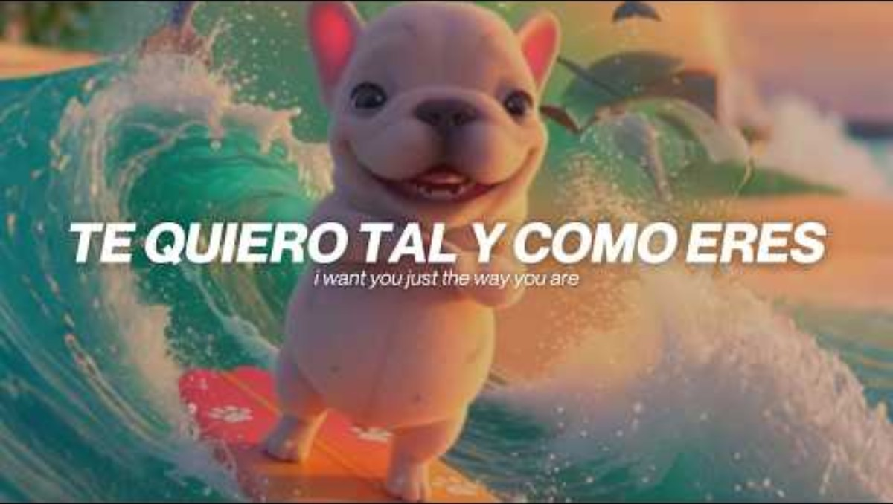
05
APPLICATIONS OF AI

Slide 32
EXAMPLES OF AI
Voice Assistants
Recommendation Systems
Self-Driving Cars
Video Game Bots
Large Language Models
Tools that understand your voice, answer questions, and complete tasks.
They rely on speech recognition and natural language processing.
Examples include Siri, Alexa, and Google Assistant.
Tools that recommend products based on what you've browsed or bought.
They use pattern detection and algorithms for recommendations.
Examples include Amazon’s storefront and eBay.
Vehicles that use AI to drive, brake, park, turn, and complete all automotive tasks.
They use real-time decision making and image recognition (see Moral Machine).
Examples include Tesla and Waymo.
Systems that control non-playable characters and adjust game difficulty.
They learn from player behaviours and try to mimic user patterns.
Examples include FIFA, and Call of Duty.
Systems that generate human-like text, answer questions, and assist with tasks.
They learn from vast datasets of human language to produce context-aware responses.
Examples include ChatGPT, Gemini, and Claude.

Slide 33
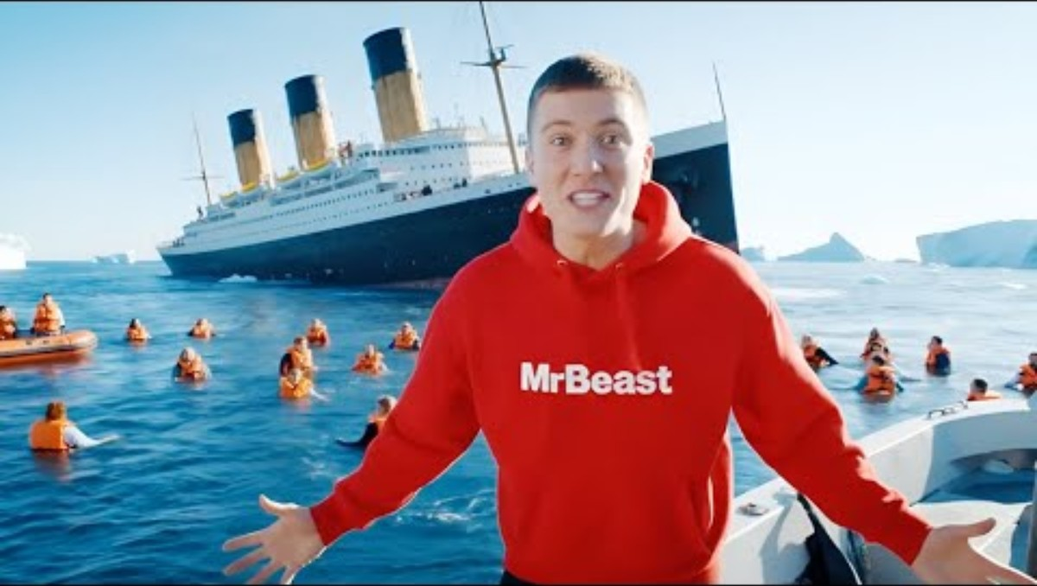
Google Veo 3

Slide 34
DISCUSSION OF GOOGLE VEO 3
What are the implications of Veo 3?
What could Veo 3 be used for?
Are there any ethical issues of Veo 3?

Slide 35
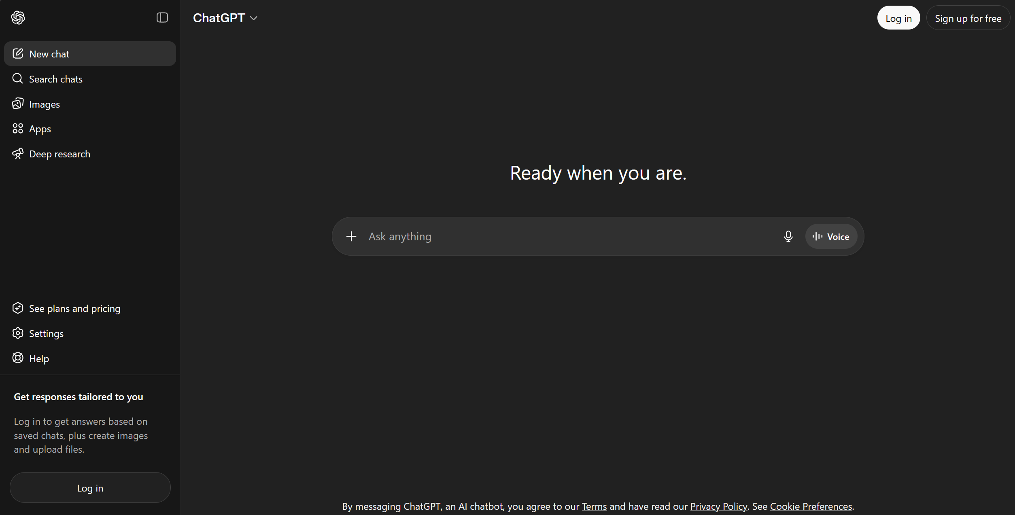

Slide 36
DISCUSSION OF CHATGPT
What are the implications of ChatGPT?
What could ChatGPT be used for?
Are there any ethical issues of ChatGPT?

Slide 37
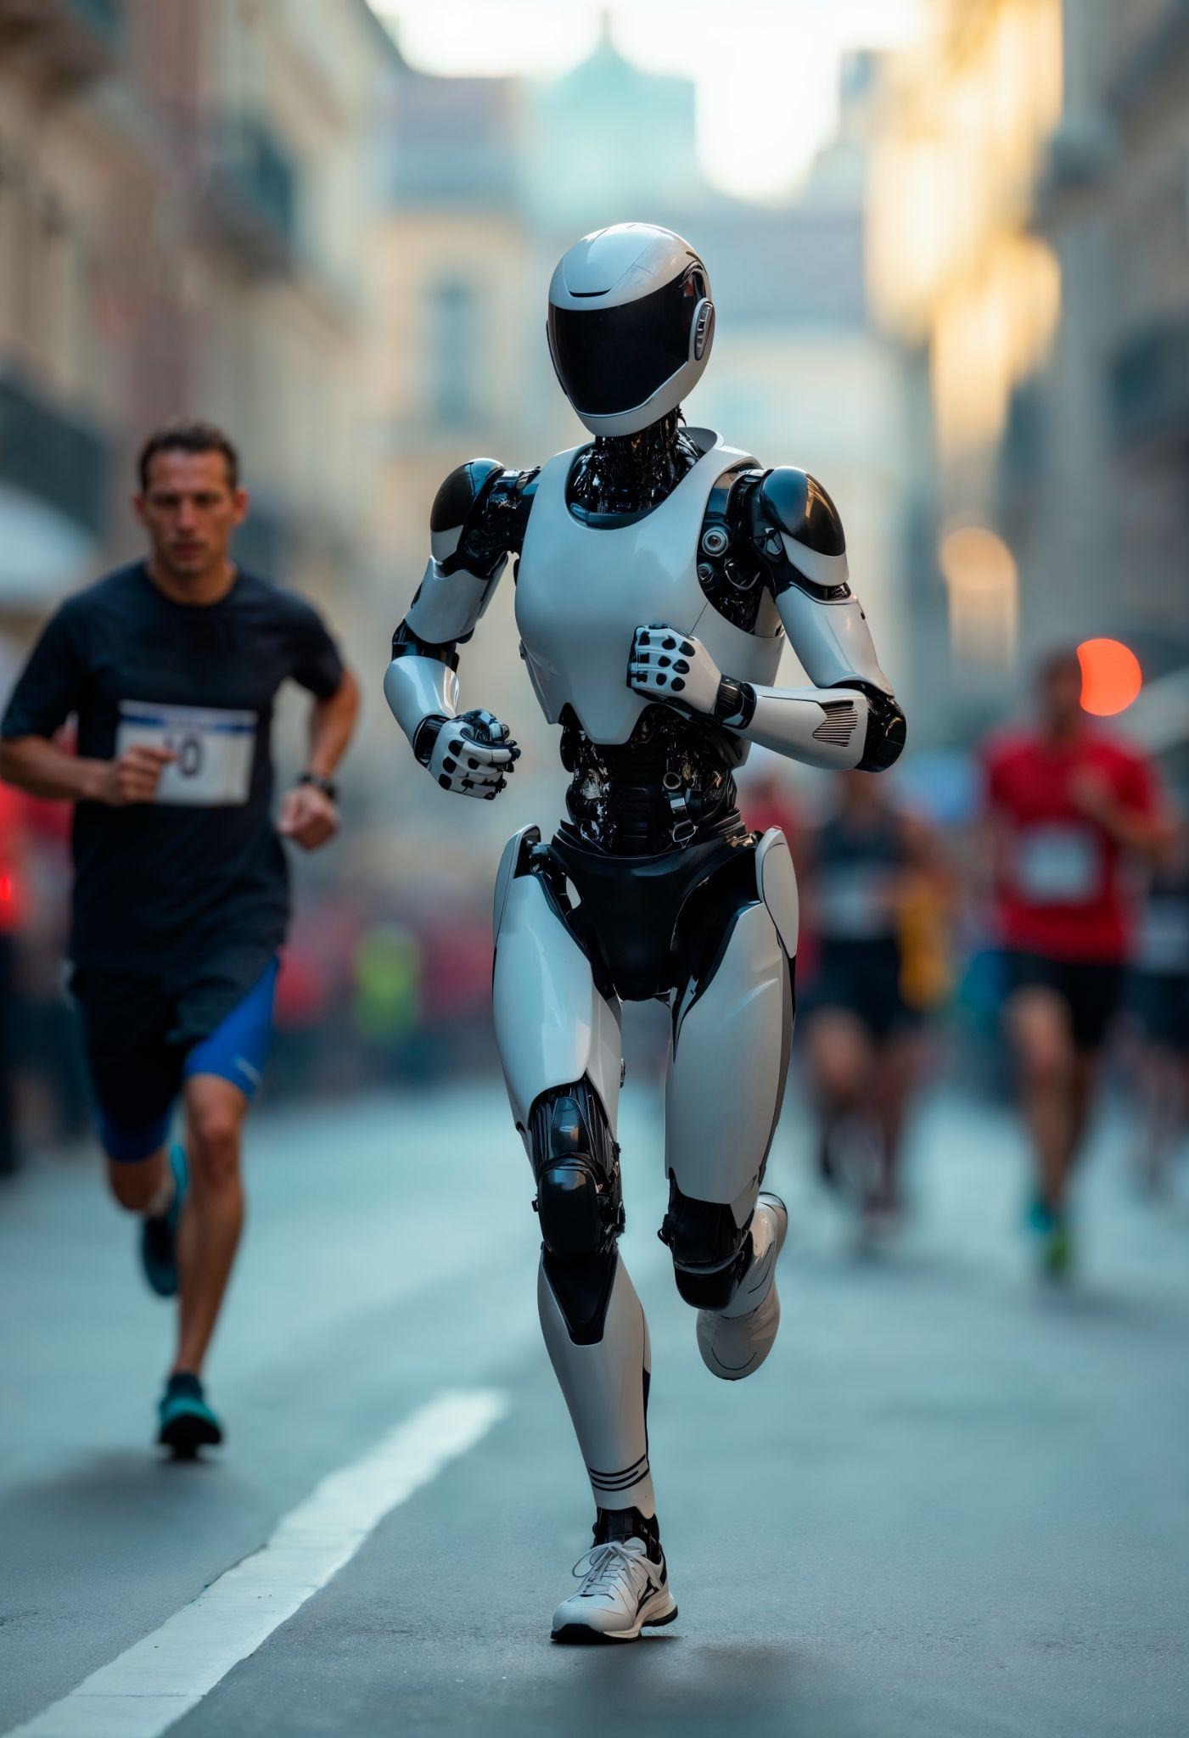
SHOULD AI REPLACE HUMAN JOBS?
What industries would benefit?
Which would suffer?

Slide 38
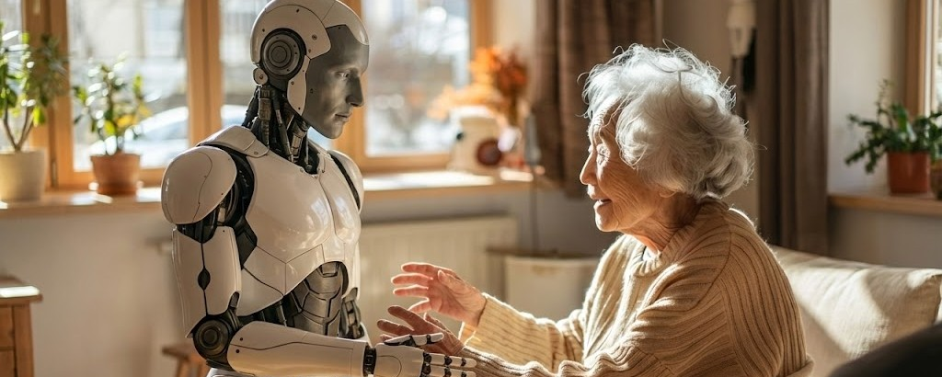
06
BENEFITS OF AI
Notes:
Image from: https://www.linkedin.com/pulse/ai-wont-destroy-humanity-well-quietly-opt-out-cornwall-watkins-gh9he

Slide 39
BENEFITS OF AI
Flexibility: Traditional programming requires reprogramming for new tasks, while AI models can learn and adapt.
Data-Driven: AI relies on vast amounts of data, whereas traditional programming depends on predefined logic.
Complex Problem-Solving: AI can recognize patterns, make predictions, and generate insights that would be difficult to program manually.

Slide 40
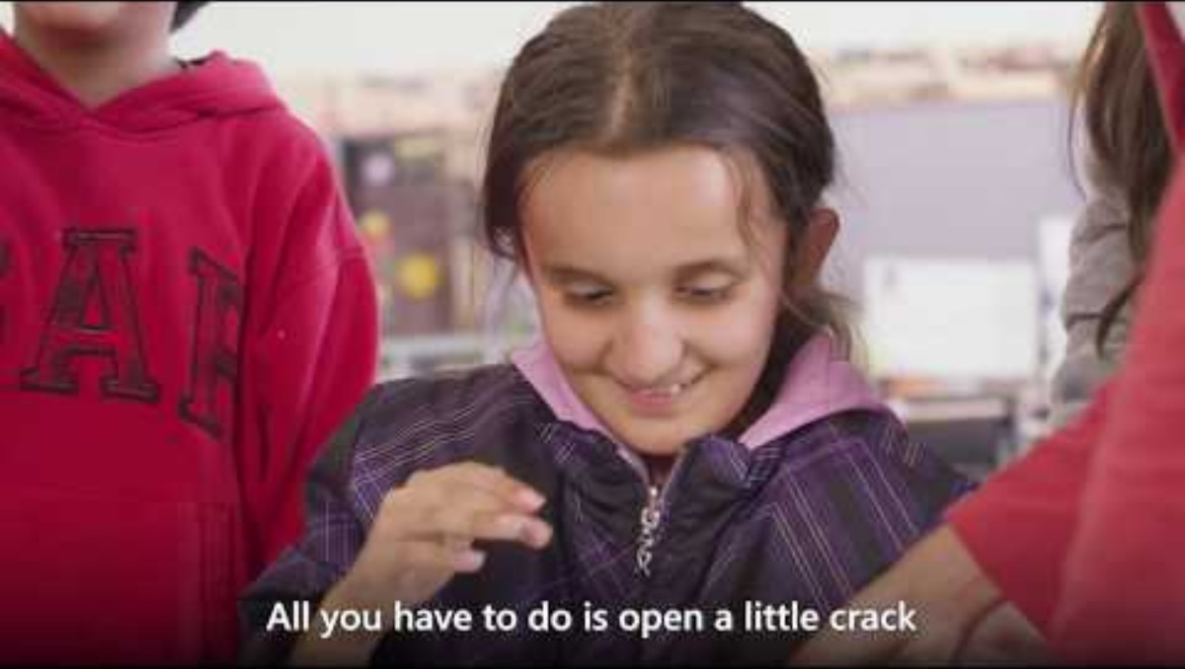

Slide 41
HOW DO YOU USE AI IN YOUR LIFE?

Slide 42
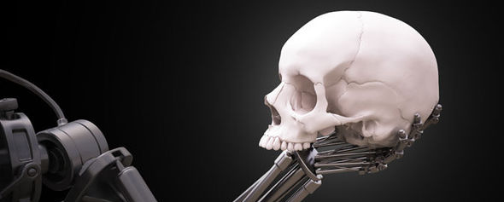
07
ISSUES OF AI
Notes:
Image from: https://www.express.co.uk/news/science/661478/END-OF-HUMANITY-Artificial-Intelligence-could-destroy-us-WITHIN-DECADES-warns-expert

Slide 43
EXAMPLES OF BIAS IN AI
Facial Recognition Errors
Some facial recognition systems have higher error rates for people with darker skin tones.
Hiring Algorithms
AI tools used for screening job applicants have favored male candidates over female candidates.
Loan Approval Systems
Some AI systems deny loans disproportionately to minority groups, even with similar financial profiles.
Predictive Policing
AI tools predicting crime hotspots have targeted minority neighborhoods unfairly.

Slide 44
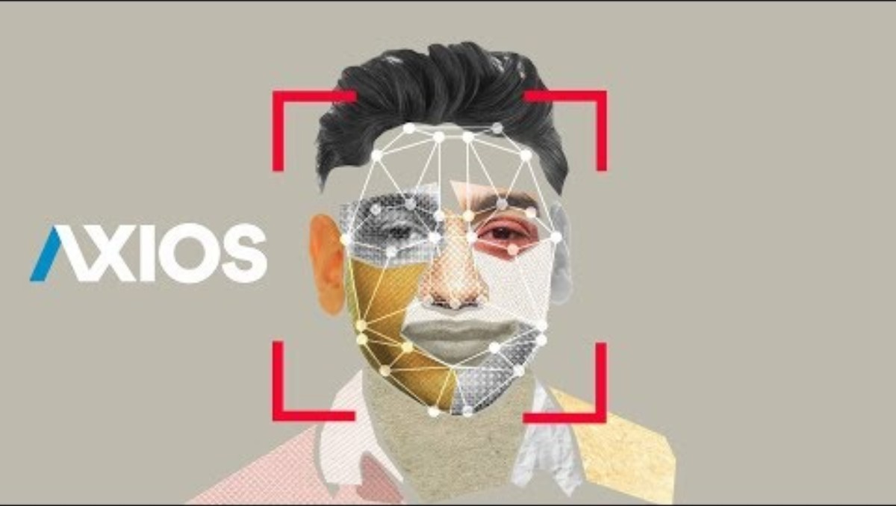

Slide 45

Notes:
Play first 1 minute

Slide 46
WHAT ISSUES HAVE YOU ENCOUNTERED?

Slide 47
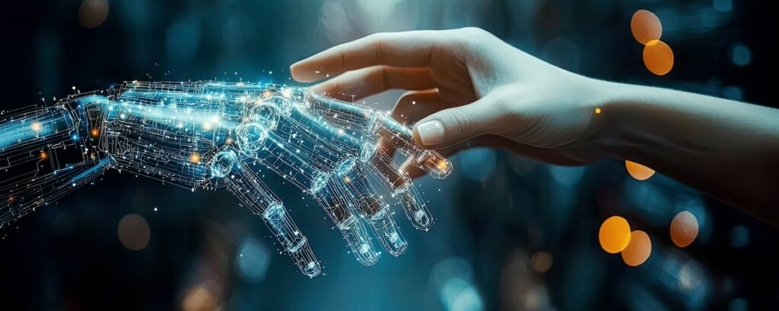
08
RESPONSIBLE AI
Notes:
Image from: https://dynamicscommunities.com/ug/women-in-tech/responsible-ai-shaping-a-future-that-includes-us-all/

Slide 48
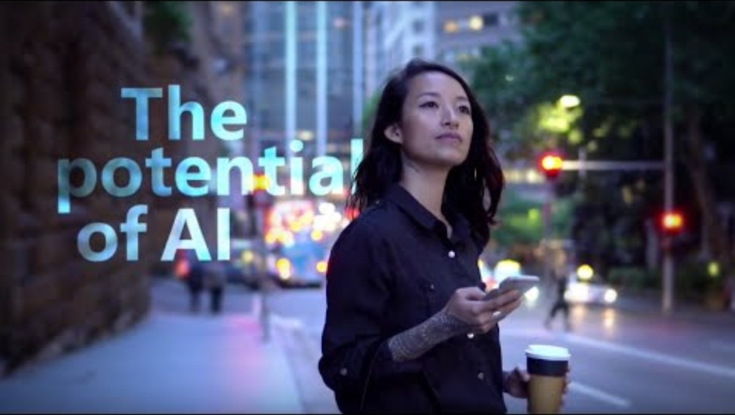

Slide 49
HOW DO WE ENSURE AI IS USED RESPONSIBLY?
What guidelines would you suggest?
How is the public responsible?

Slide 50
THANK
YOU
Do you have any questions?

